Slide 2

SYSTEM OVERVIEW
1
The portal provides the facility to book a photographer online.
2
To book a photographer the customer will just have to register on the website.
3
The website consists a list of photography categories to choose from.
4
The aim of this portal is to provide a best photography in a easy way.

Slide 3
Existing System
To book a photographer the customer has to visit different photo studios.
After the selection of the convincing photo studio the customer has to tell the requirements regarding the photography to the photographer.
Then the customer is able to book a potographer by paying some money in advance.

Slide 4



CUSTOMER
The customer would give the booking request on the website.
WEBSITE
The order request would be sent to the photographer through the website.
BASIC PROCESS
PHOTOGRAPHER
The photographer will follow the order request and give service to the customer.

Slide 5
PHOTO& VIDEO
GRAPHY
CATEGORIES
MARRIAGE
CEREMONEY
BIRTHDAY
PARTY
EVENT
CASUAL
PHOTOSHOOT
TRIP
FUNCTION

Slide 6
Customer’s Part
Customer will login to the website.
Customer will choose the required photography category or search.
A list of photographer and their charge will be displayed.
Customer will select a photographer by their choice.
The customer will enter the location and full accurate address where he/she want to get the service.
The customer choose a payment method and his/her booking will be confirmed.
After getting the service the customer will rate and review the service.

Slide 7
Problem solved
The problem of going to places and searching for a good photographer is solved which saves time and effort.
Now anybody can book a photographer from anywhere.
The bargaining issues would also be solved.
The every thing regarding photography will be available on one platform.
The earning of photographers would increase.

Slide 8
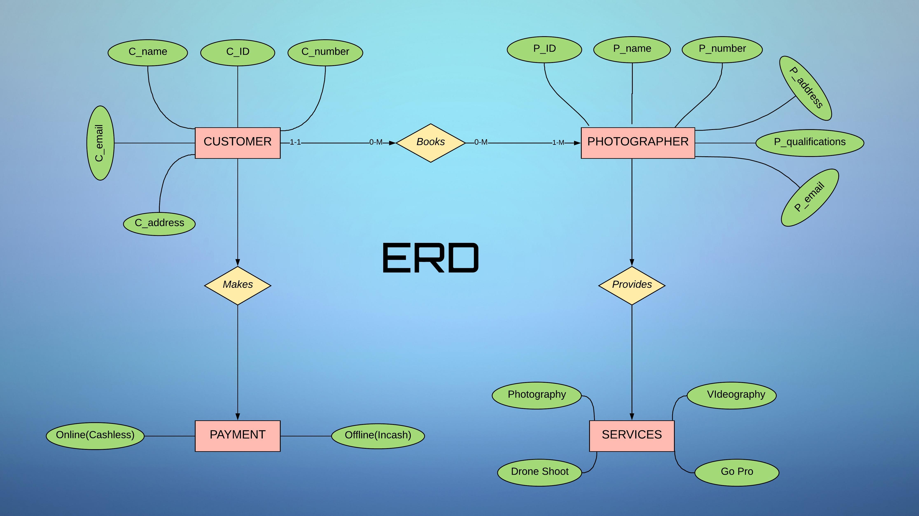

Slide 9
